Slide 1
Football transfers
Supervised by: Dr/ Hisham Assem
Nora Ibraheem
Asaad Mohammed
Yousef Mohammed
Khaoula Elbriki
Aya Mohammed

Slide 2
AGENDA
Intro to Dataset
Dataset Problems
Visualization
preprocessing
Data Modeling
​Summary​

Slide 3
Business Question
This dataset includes all the operations in the summer window, whether transfers. It is an optimal dataset to perform EDA or analysis of transfer market data by club, country or league. we want to predict the cost of players by using ML algorithms. This has an important effect in investments and other applications.

Slide 4
Dataset insights
Dataset shape : (33625,11)
data contains on 10 features ( categorical data) and one column is numerical data
Columns:
Name : 32577 unique values and top player is Rafinha.
Position : 16 unique and top position is center_back.
OriginClub: 5819 unique values and top value is without club .
LeagueOriginClub: 492 unique countries and top country is Italy.
CountreyOriginClub: 153 unique countries and top is Italy.
NewClub : 6317 unique country and top club is without club .
LeagueNewClub :463 unique values and top country is Italy.
CountreyNewClub: 139 unique values and top country is Italy.
Cost : 118 unique values and €50Th is the top.
DateOfTransfer : 63 unique values and top date is 1/7/2022.

Slide 5
Dataset problems
Some columns has vales that doesn’t have meaning such as Unknown , without club , Retired and career break.
Column cost is object and contains symbols as € , th , . and m . It needs to filtering and converts it into numerical.
Column Date of transfer is an object not date.
There are NaN values in almost null columns .
Renaming columns , becomes it easy to use .
Range Constrains and remove outliter in Cost feature.

Slide 6
Handling dataset problems
column by column

Slide 7
Columns doesn’t have meaning
Renaming columns
Name
Position
Age
OriginClub
LeagueOriginClub
CountryOriginClub
NewClub
LeagueNewClub
CountryNewClub
Cost
MonthOFtransfer
Replacing all to No club .

Slide 8

Handling object Columns
DateOfTransfer
convert it into date by using pd.to_datetime
create a month column which extracts from DateOfTransfer column
Cost Feature

Slide 9
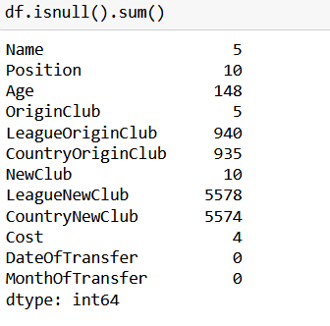
missing values
Using interpolate to impute missing numerical value in Age and Cost column
Fill null values in position column with the most common value
Drop null values in categorical data.

Slide 10

Data range constrains
Ex) Cost & position

Slide 11
Data Visualization

Slide 12
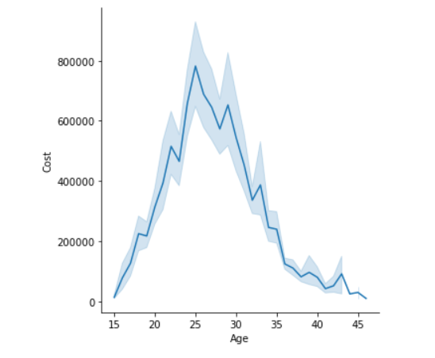
Is Age of player affect on cost ?
Age of player affect on his cost (20-35 is high cost and budding player is less cost).

Slide 13
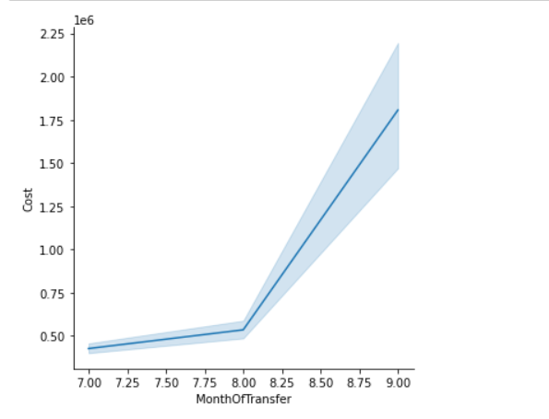
Is month of transfer affect on cost?
If player transfers in month 9 , his cost will be high.
If player transfers in month 7 , his cost will be low.

Slide 14
Some Insights
Which position of player has the most expensive price ?
when position of player is center-back is most expensive one
which country have spent more money?
Monaco is the country which spent more money for transferring player to it
Average of cost in every Clubs
Paris Sanit-Germain is the highst club spent money for data transfers
which leagueNewClub spent more cost for players?
LaLiga is the most league club spent more money for players

Slide 15
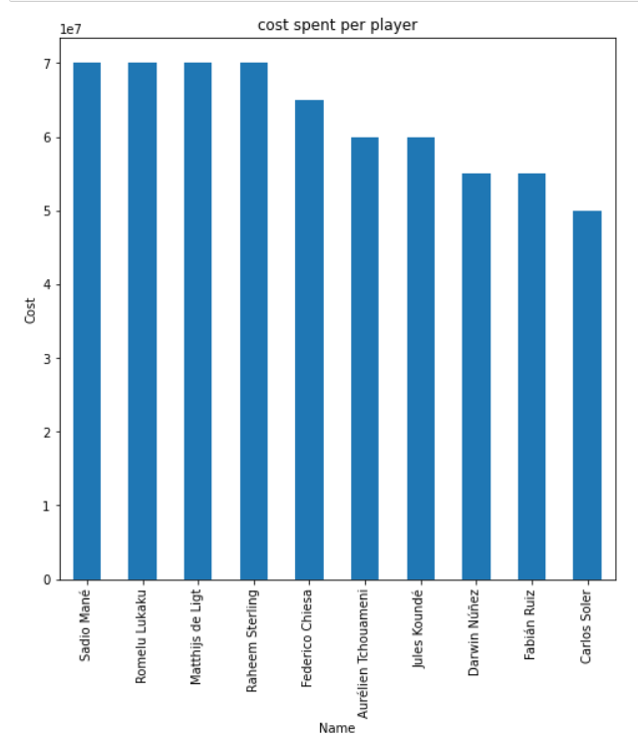
Top 10 Players in football transfer market
sadio mane, romelu lukaku , matthijs de light, raheem sterling are the most expensive players in footaball transfer.

Slide 16
Preprocesing
Converting categorical data into numerical by using label encoder
Divide data into input data and target
target = Cost
input = All features except Cost and DateOfTransfer

Slide 17
Splitting dataset into training and testing data by using train_test_split 70% - 30%
Scaling all features in specific range based on equation z=(x-u)/s
By using StandardScaler.

Slide 18
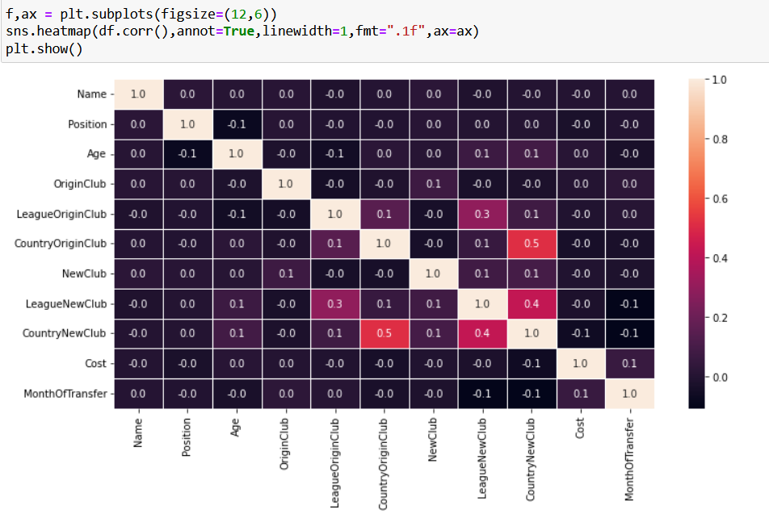
Features Correlation

Slide 19
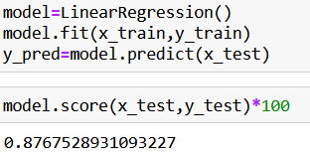
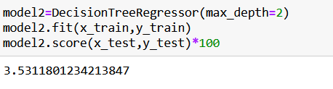
Modeling
Linear Regression
2. Decision Tree

Slide 20

Football Transfers
3. KNN

Slide 21
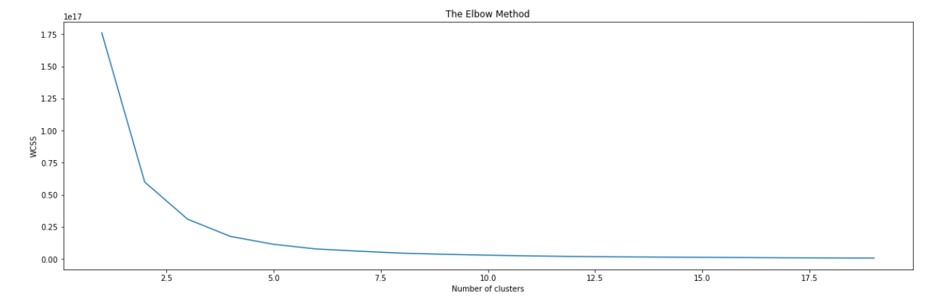
3. Clustering
Divide dataset into groups of age based on cost of each group.
Determine Age and Cost Columns which are the input of K-means algorithm.
Using the elbow method to find the optimal number of clusters(k-numbers).

Slide 22
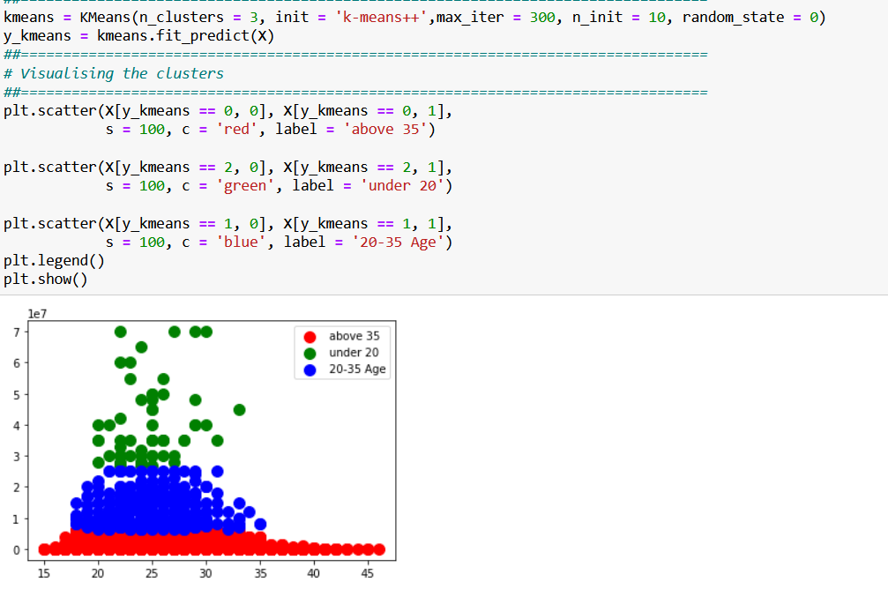
build the model by using k-means algorithm.

Slide 23
Conclusion
Here we reached at the end of the report which have involved :
the descripthion of our data
the information about its features
visualization them
cleaning undesrible data
finding relations between features
modeling by using ML algorithms as linear regression , Decision tree , knn and clustering

Slide 24
THANK YOU

